Slide 1
Physical Optics
Dr. Dipankar Bhattacharyya
Department of Physics, Santipur College

Slide 2
Plan of Presentation
# Interference of light
# Diffraction of light
# Polarisation of light
# Laser
#Interferometers
# References

Slide 3
What is Interference ?
When two light sources are simultaneously excited, then under certain conditions being fulfilled by the two sources, waves from these two sources superpose, producing on a screen alternate region of darkness and brightness. This phenomenon is referred to as interference and the pattern consisting of alternate regions of darkness and brightness is called Interference Pattern.
In constructive interference (i.e. bright lines) the amplitude of the resultant wave is greater than that of either individual wave.
In destructive interference (i.e. dark lines) the amplitude of the resultant wave is less than that of either individual wave.
All interference associated with light waves arises when the electromagnetic fields that constitute the individual waves combine.

Slide 4
Conditions for Interference
To observe interference in light waves, the following two conditions must be met:
The sources must be coherent.
They must maintain a constant phase with respect to each other.
The sources should be monochromatic.
Monochromatic means they have a single wavelength.
Producing Coherent Sources
Light from a monochromatic source is used to illuminate a barrier.
The barrier contains two small openings.
The openings are usually in the shape of slits.
The light emerging from the two slits is coherent since a single source produces the original light beam.
This is a commonly used method.

Slide 5
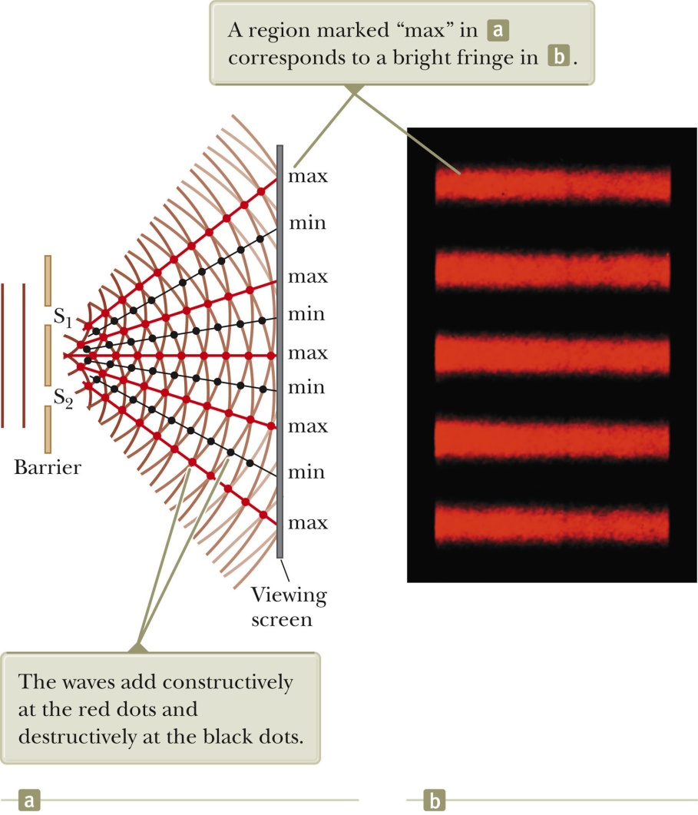
Young’s Double-Slit Experiment: Schematic
Thomas Young first demonstrated interference in light waves from two sources in 1801.
The narrow slits S₁ and S₂ act as sources of waves.
The waves emerging from the slits originate from the same wave front and therefore are always in phase.
fig. 1

Slide 6
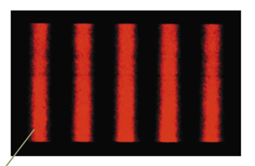
Resulting Interference Pattern
The light from the two slits forms a visible pattern on a screen.
The pattern consists of a series of bright and dark parallel bands called fringes.
Constructive interference occurs where a bright fringe occurs.
Destructive interference results in a dark fringe.
Bright fringe
Dark fringe
fig. 2

Slide 7
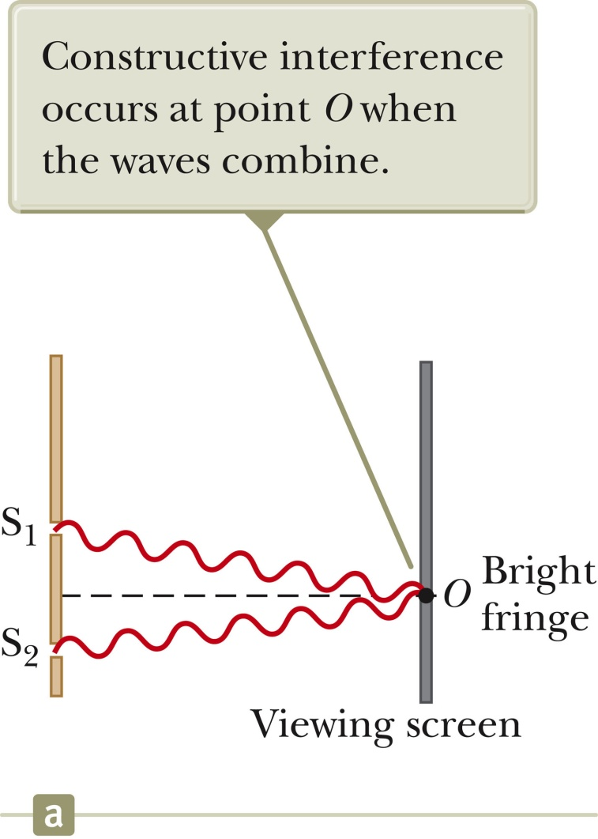
Interference Patterns
Constructive interference occurs at point O.
The two waves travel the same distance.
Therefore, they arrive in phase
As a result, constructive interference occurs at this point and a bright fringe is observed.
fig. 3

Slide 8
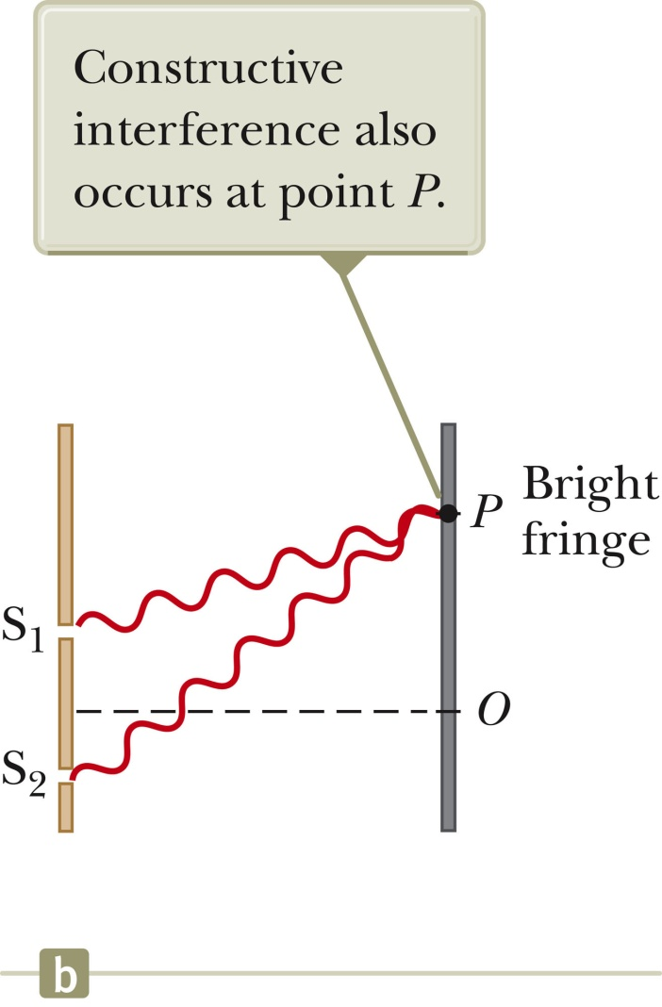
Interference Patterns, 2
The lower wave has to travel farther than the upper wave to reach point P.
The lower wave travels one wavelength farther.
Therefore, the waves arrive in phase
A second bright fringe occurs at this position.
fig. 3

Slide 9
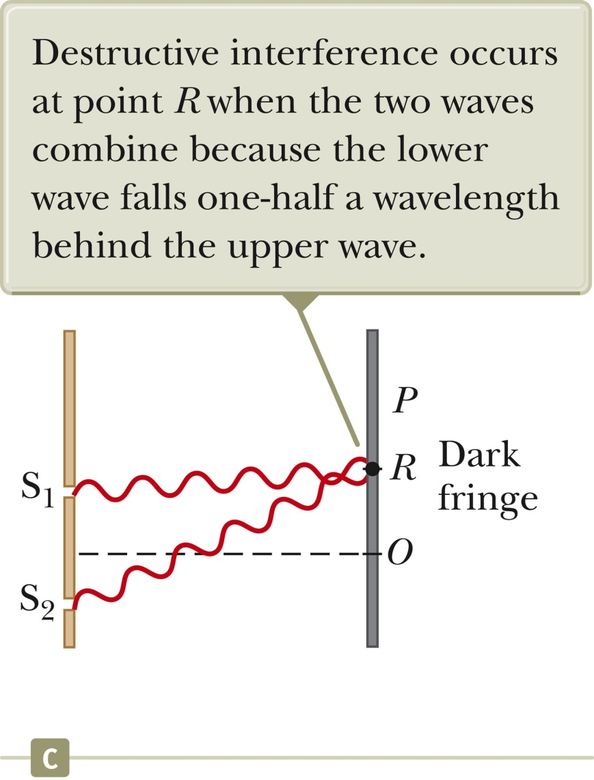
Interference Patterns, 3
The lower wave has to travel farther than the upper wave to reach point P.
The lower wave travels one wavelength farther.
Therefore, the waves arrive in phase
A second bright fringe occurs at this position.
fig. 4

Slide 10
Conditions for Interference
To observe interference in light waves, the following two conditions must be met:
The sources must be coherent.
They must maintain a constant phase with respect to each other.
The sources should be monochromatic.
Monochromatic means they have a single wavelength.

Slide 11
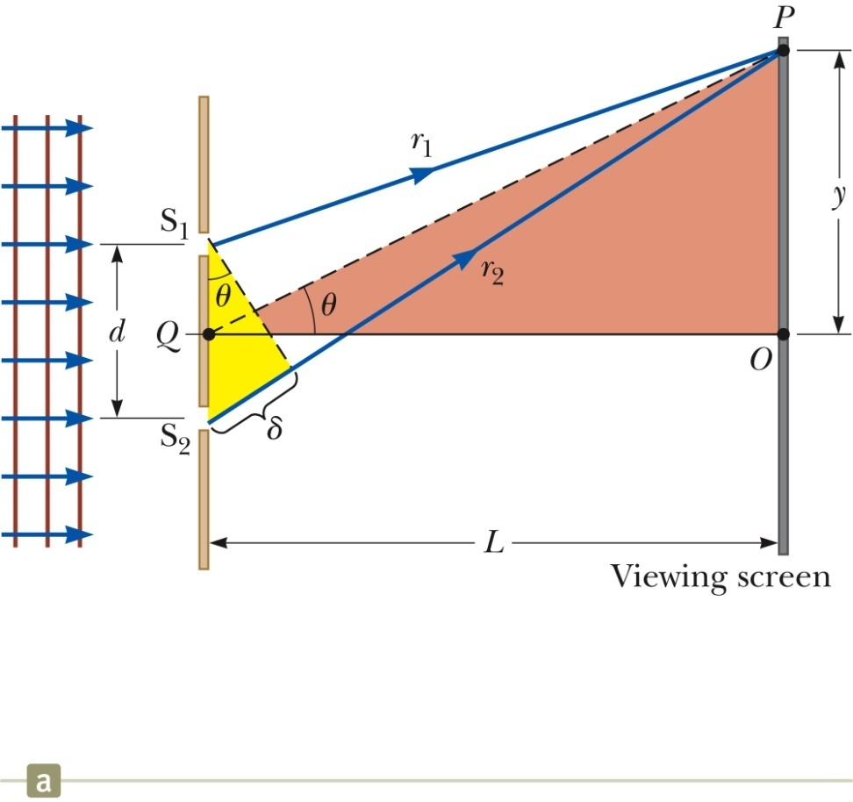
Young’s Double-Slit Experiment: Geometry
The path difference, δ, is found from geometry.
δ = r₂ – r₁ = d sin θ
This assumes the paths are parallel.
Not exactly true, but a very good approximation if L is much greater than d
fig. 5

Slide 12
Interference Equations
For a bright fringe produced by constructive interference, the path difference must be either zero or some integer multiple of the wavelength.
δ = d sin θ_{bright} = mλ
m = 0, ±1, ±2, …
m is called the order number
When m = 0, it is the zeroth-order maximum
When m = ±1, it is called the first-order maximum
When destructive interference occurs, a dark fringe is observed.
This needs a path difference of an odd half wavelength.
δ = d sin θ_{dark} = (m + ½)λ
m = 0, ±1, ±2, …
The positions of the fringes can be measured vertically from the zeroth-order maximum.
Using the large triangle in fig. 37.5,
y_{bright} = L tan q_{bright}
y_{dark} = L tan q_{dark}

Slide 13
Interference Equations, cont.
Assumptions in a Young’s Double Slit Experiment:
L >> d
d >> λ
Approximation:
θ is small and therefore the small angle approximation tan θ ~ sin θ can be used
y = L tan θ ≈ L sin θ
For small angles,
Uses for Young’s Double-Slit Experiment
Young’s double-slit experiment provides a method for measuring wavelength of the light.
This experiment gave the wave model of light a great deal of credibility.
It was inconceivable that particles of light could cancel each other in a way that would explain the dark fringes.

Slide 14
Diffraction
If the light traveled in a straight line after passing through the slits, no interference pattern would be observed.
From Huygens’s principle we know the waves spread out from the slits.
This divergence of light from its initial line of travel is called diffraction.

Slide 15
Intensity Distribution: Double-Slit Interference Pattern
The bright fringes in the interference pattern do not have sharp edges.
The equations developed give the location of only the centers of the bright and dark fringes.
We can calculate the distribution of light intensity associated with the double-slit interference pattern.
Assumptions:
The two slits represent coherent sources of sinusoidal waves.
The waves from the slits have the same angular frequency, ω.
The waves have a constant phase difference, φ.
The total magnitude of the electric field at any point on the screen is the superposition of the two waves.

Slide 16
The magnitude of each wave at point P on a screen can be found.
E₁ = E_{o} sin ωt
E₂ = E_{o} sin (ωt + φ)
Both waves have the same amplitude, E_{o.}
The phase difference between the two waves at P depends on their path difference.
δ = r₂ – r₁ = d sin θ
A path difference of λ (for constructive interference) corresponds to a phase difference of 2π rad.
A path difference of δ is the same fraction of λ as the phase difference φ is of 2π.
This gives

Slide 17
Intensity Distribution, Resultant Field
The magnitude of the resultant electric field comes from the superposition principle.
E_{P} = E₁+ E₂ = E_{o}[sin ωt + sin (ωt + φ)]
This can also be expressed as
E_{P} has the same frequency as the light at the slits.
The magnitude of the field is multiplied by the factor
2 cos (φ / 2).

Slide 18
Intensity Distribution, Equation
The expression for the intensity comes from the fact that the intensity of a wave is proportional to the square of the resultant electric field magnitude at that point.
The intensity therefore is

Slide 19
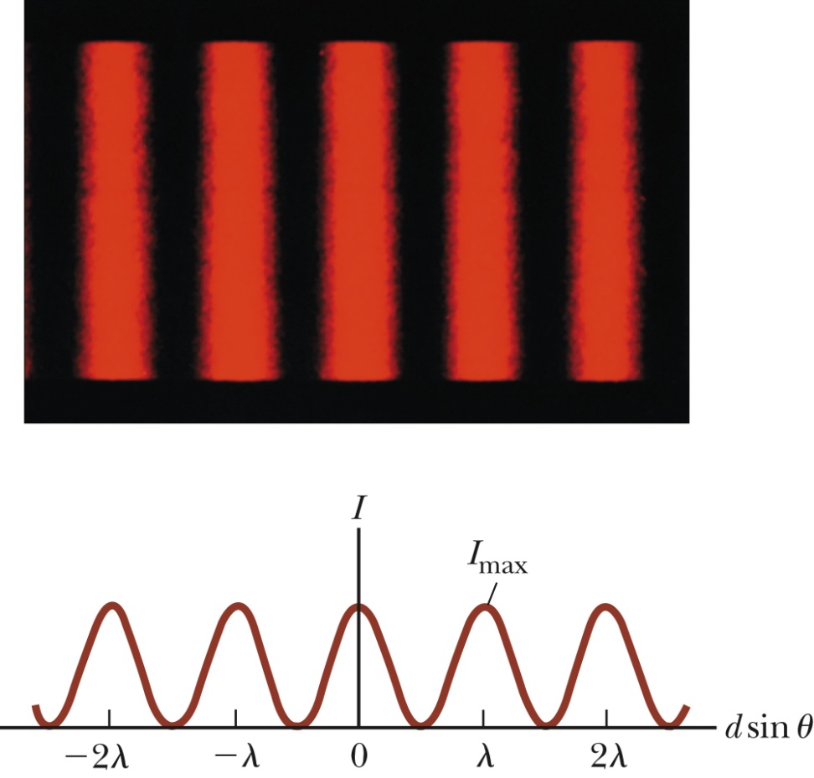
Light Intensity, Graph
The interference pattern consists of equally spaced fringes of equal intensity.

Slide 20
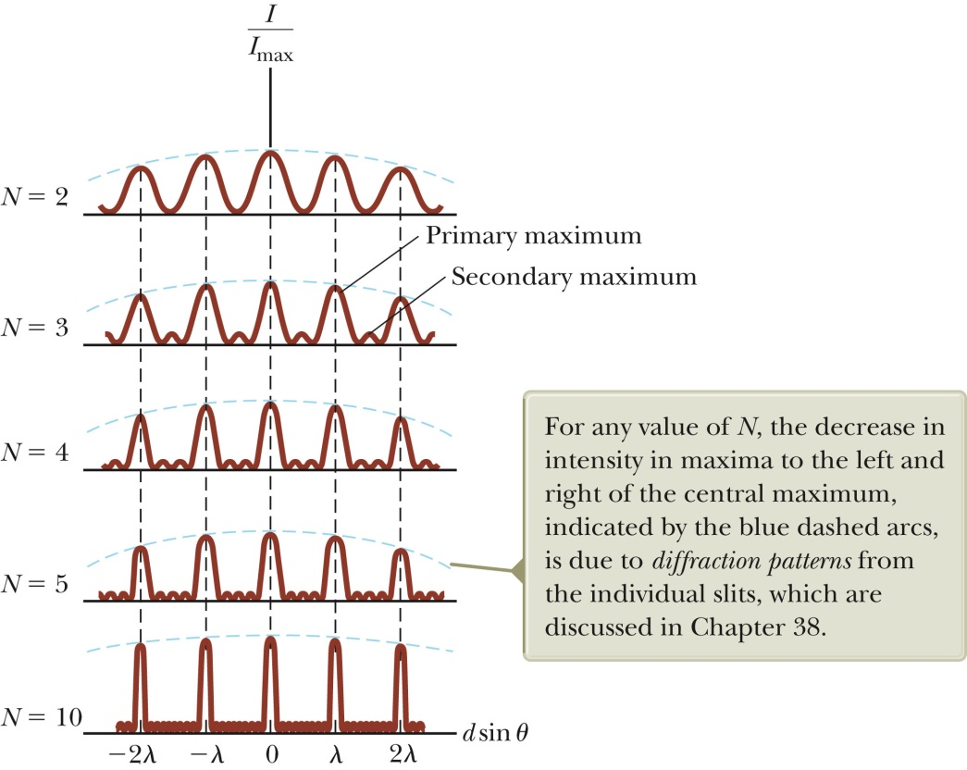
Multiple Slits, Graph
With more than two slits, the pattern contains primary and secondary maxima.
For N slits, the intensity of the primary maxima is N² times greater than that due to a single slit.
As the number of slits increases, the primary maxima increase in intensity and become narrower.
The secondary maxima decrease in intensity relative to the primary maxima.
The number of secondary maxima is N – 2, where N is the number of slits.

Slide 21
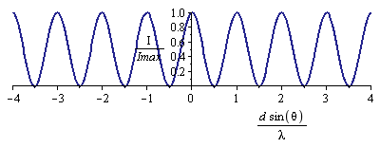
Interference Through Two Slits
Where is it bright?
Where is it dark?

Slide 22
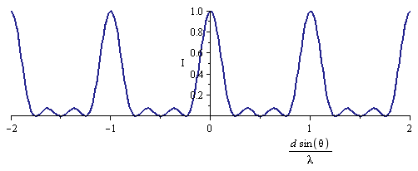
Interference Through Four Slits
What if we have more than two slits?
Four slits, each spaced distance d apart
Treat it as two double slits
r_{3,4}
r_{1,2}
P
For four slits, every third band is bright

Slide 23
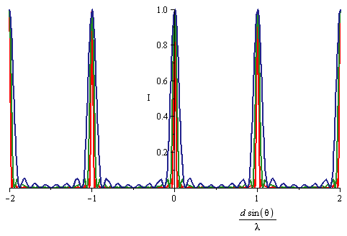
More Slits and Diffraction Gratings
This process can be continued for more slits
For N slits, every N – 1’th band is bright
For large N, bands become very narrow
A device called a diffraction grating is just transparent with closely spaced regular lines on it
N = 8 N = 16 N = 32
Diffraction gratings are another way to divide light into different colors
More accurate way of measuring wavelength than a prism

Slide 24
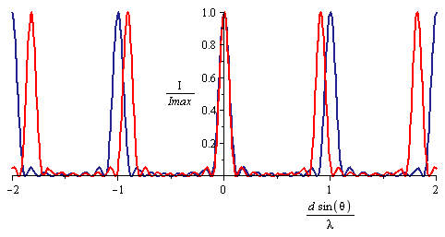
Resolution of Diffraction Gratings
Note that the angle depends on the wavelength
With a finite number of slits, nearby wavelengths may overlap
λ 1.1λ
The width of the peaks is about
The difference between peaks is
We can distinguish two peaks if:
N = 8
This quantity (mN) is called the resolving power
Even if N is very large, effectively N is how many slits the light beam actually falls on

Slide 25
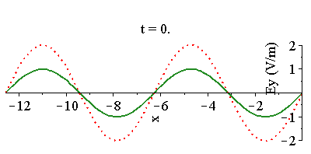
Reflection and Phase Shift
When you reflect off of a mirror, the reflected wave must cancel the incoming wave
It has a π phase shift
When you go from a low index of refraction medium to a high one, some of the wave is reflected
It also has a π phase shift
π phase shift
π phase shift
When you go from a high index of refraction medium to a low one, some of the wave is reflected
This has a 0 phase shift
0 phase shift

Slide 26
Interference From Thin Films
Suppose we go through a thin soap film
Index goes up then down
Front surface:
Phase shift of π from reflection (low-high)
Back surface:
Phase shift of 2πt/λ from traveling
Phase shift of 0 from reflection
Phase shift of 2πt/λ from traveling
Total phase shift between two reflected waves:
Weak reflection when odd times π:
Strong reflection when even
Same results for index down then up
Opposite for:
Index up, then up
Index down, then down
t

Slide 27
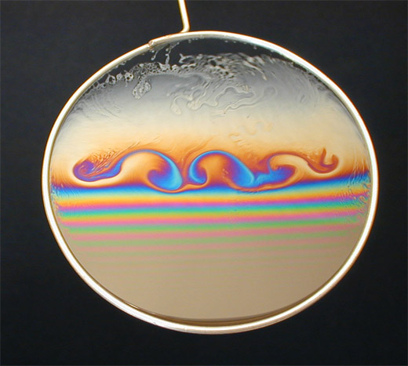
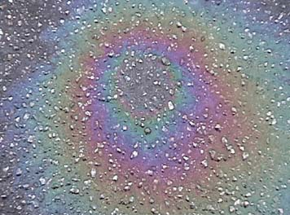
Applications of Thin Films Interference
What if the light isn’t monochromatic?
Some wavelengths are enhanced, others are not
Soap bubbles
Oil on water
Newton’s rings: convex lens on flat glass plate
Air gap changes thickness in circular pattern
Alternating light/dark regions
d
narrow air gap

Slide 28
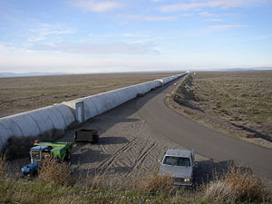
Michelson Interferometer
Interference easy to measure
Can see much smaller than one wavelength
LIGO, state of the art, can see 10⁻¹⁵ m!
Mirrors
Hanford, Washington
Laser
Detector

Slide 29
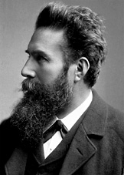
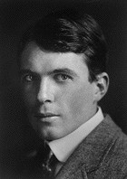
Crystal Scattering of X-rays
Mysterious rays were discovered by Röntgen in 1895
Suspected to be short-wavelength EM waves
Order 1-0.1 nm wavelength
Scattered very weakly off of atoms
Bragg, 1912, measured wavelength accurately
θ
θ
Scattering strong only if waves are in phase
Must be integer multiple of wavelength
dcosθ
d
dcosθ

Slide 30
Polarization
Recall that light waves have electric and magnetic fields perpendicular to the direction of motion
But there are two independent ways of arranging this
Called polarization
Our eyes can’t tell these two polarizations apart
But some instruments can measure or take advantage of polarization
We describe polarization by telling which direction the electric field points, e.g. vertically or horizontally
B₀
E₀
E₀
B₀

Slide 31
Methods of Producing Polarization
Direct production
Antennas produce waves that are automatically polarized
Scattering
Light waves of all orientations hit small targets
Target has vibrating charges, like an antenna
Reflection and Brewster’s Angle:
When light hits a substance, some of it reflects and some refracts
Fraction of each depends on polarization
There’s a special angle – Brewster’s angle – where reflected is completely polarized
++++++
–––
E₀
n₁
θ_{P}
n₂

Slide 32
Methods of Producing Polarization
Birefringent Crystals
Index of refraction has to do with electric fields from the wave pushing atoms around
In some crystals, it is easier to push them one way than another
Index of refraction depends on polarization
You can use such birefringent crystals to sort light based on polarization
Selective absorption
Similarly, some materials absorb one polarization better than another
E₀
E₀
E₀
E₀
E₀

Slide 33
Some Uses for Polarization
Polarized Sun Glasses
“Glare” comes mostly from light scattered in the atmosphere and reflected from water
Mostly polarized
Sun glasses use selective absorption to eliminate it
Optical Activity
Some materials are capable of rotating the plane of polarization
These materials are not mirror-symmetric
Enantiomers, especially biological molecules
Studying rotation of polarized light detects presence of these molecules
Someday use these to detect life on other planets?
E₀
Sugar water
E₀

Slide 34
Reference List:
Geometrical and Physical Optics by Longhurst – Longmans.
2. Optics by A. Ghatak – Tata McGraw Hill.
3. Optics, by Eugene Hecht, 4th Edition, Pearson Addison Wesley.
4. Optics by K. G. Majumder and B. Ghosh

